Slide 1














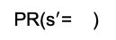

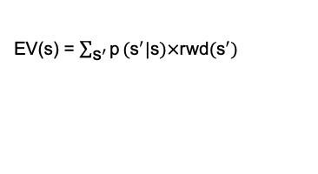
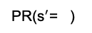

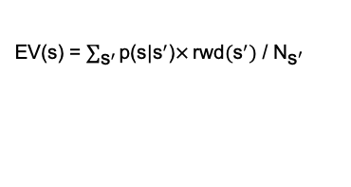
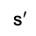
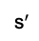
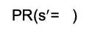
A
State Space
C
Successor Representation
Predecessor Representation
Base Rate
\\
156
208
137
137
0
1
0
1
p($\text{s}$|${\text{s}}^{′}$)
p(${\text{s}}^{′}$|$\text{s}$)
D
Computation
EV(s) = $\sum_{{\text{s}}^{′}}{\text{p}}({\text{s}}^{′}|\text{s})×$rwd$({\text{s}}^{′})$
EV(s) = $\sum_{{\text{s}}^{′}}{\text{p}\text{(}\text{s}\text{|}{\text{s}}^{′}\text{)}×}\text{r}\text{wd}({\text{s}}^{′})$ / ${\text{N}}_{{\text{s}}^{′}}$
0
State transition probability
1
${\text{s}}^{′}$
s
SR(s= )
PR(${\text{s}}^{′}$= )
.38 | .62 | .33 | .67
B
.48 | .02 | .48 | .02 | .28 | .09 | .12 | .01 | .12 | .01 | .28 | .09
$$×$$
$$×$$
$$×$$
$$×$$
$$×$$
$$×$$
$$×$$
$$×$$
$$×$$
$$×$$
$$×$$
$$×$$
$$×$$
$$×$$
$$×$$
$$×$$
rwd( )
rwd
0 | 0 | 156 | 0 | 0 | 0 | 0 | 208 | 0 | 0 | 0 | 137
137 | 137 | 137 | 137
Task Structure
sum
EV( ) = 103
PR(${\text{s}}^{′}$= )
.95 | .05
Learning
Decision
Post
Map-Change
$$×$$
$$×$$
${\text{s}}^{′}$
rwd( )
156 | 156
Forced Choice
Map Change
SR(s= )
.05 | .45 | .05 | .45 | .09 | .28 | .01 | .12 | .01 | .12 | .09 | .28
Reward Info
$$×$$
$$×$$
$$×$$
$$×$$
$$×$$
$$×$$
$$×$$
$$×$$
$$×$$
$$×$$
$$×$$
$$×$$
PR(${\text{s}}^{′}$= )
137
rwd
.10 | .90 | 1
208
1st Transition
156
Reward Info
0 | 0 | 156 | 0 | 0 | 0 | 0 | 208 | 0 | 0 | 0 | 137
$$×$$
$$×$$
$$×$$
Choose
rwd( )
208 | 208 | 208
100
sum
Time
Time
Time
EV( ) = 103
Left
Choose
2nd Transition
Right
EV( )=73
average
average
EV( )=93
Left
Right
SR: 24 predictions retrieved
Retrieval Costs
PR: 9 predictions retrieved
Notes:
if current_outcome>0:

Slide 2
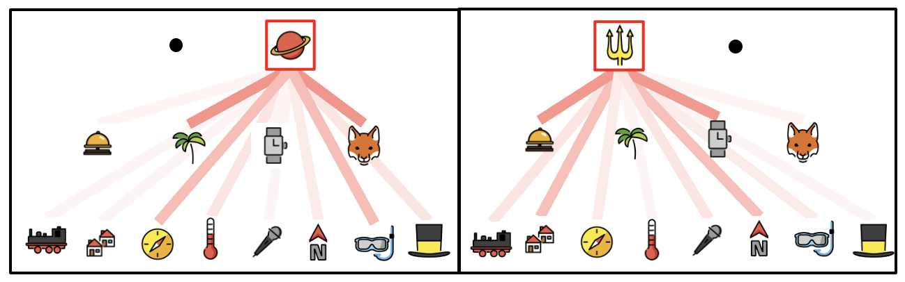
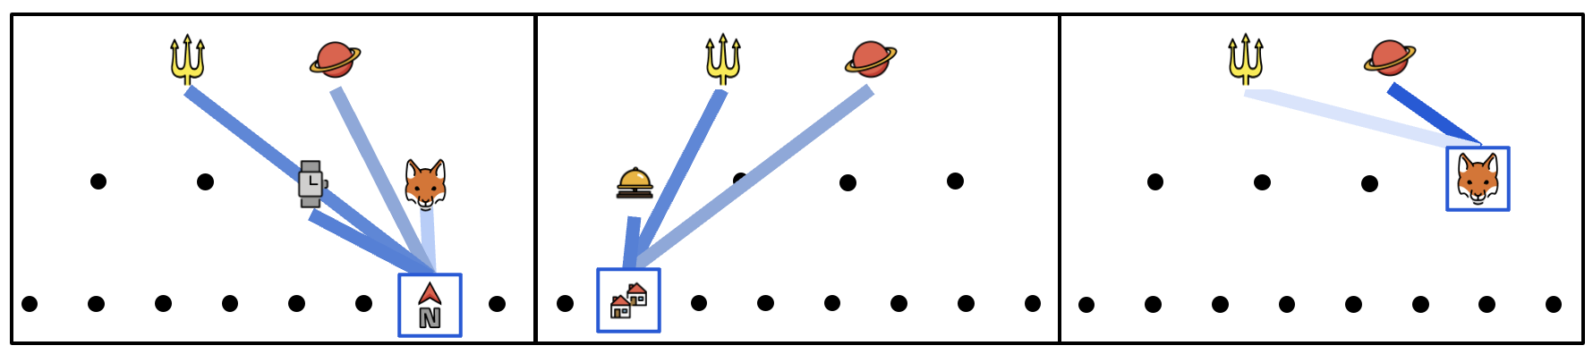
E
Efficiency
24 successor predictions
9 predecessor predictions

Slide 3
Forward Prediction
State Space
\\
Base Rate
\\
0
1
state transition probability
Task Structure
74+12+17=103
Learning
Decision
Post Map-Change Decision
7+38+58=103
Forced Choice
Map Change
Reward Info
137
208
1st Transition
156
Reward Info
Choose
100
Time
Time
Time
Left
Choose
2nd Transition
Right
Left
Right

Slide 4
Predecessor Representation
84
53
\\
\\
137
\\
129
79
\\
208
7
149
156

Slide 5
Predecessor Representation
\\
\\

Slide 6
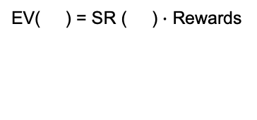
State Space
Successor
Representation
Predecessor
Representation
0
1
Fwd probability
Base Rate
84
53
0
1
\\
\
Bwd probability
156
137
208
137
129
79
\\
\\
156
0
1
state transition probability
208
208
137
Task Structure
EV( ) = SR ( ) $∙$ Rewards
Learning
Prediction
Test PR/SR
Rewards
7
149
Forced Choice
Map Change
SR ( )
0
0
156
0
0
0
0
208
0
0
0
137
Reward Info
.45 | .05 | .45 | .05 | .28 | .10 | .11 | .01 | .11 | .01 | .28 | .10
156
137
208
1st Transition
156
Reward Info
Choose
100
Time
Time
Time
Left
Choose
2nd Transition
Right
Left
Right

Slide 7
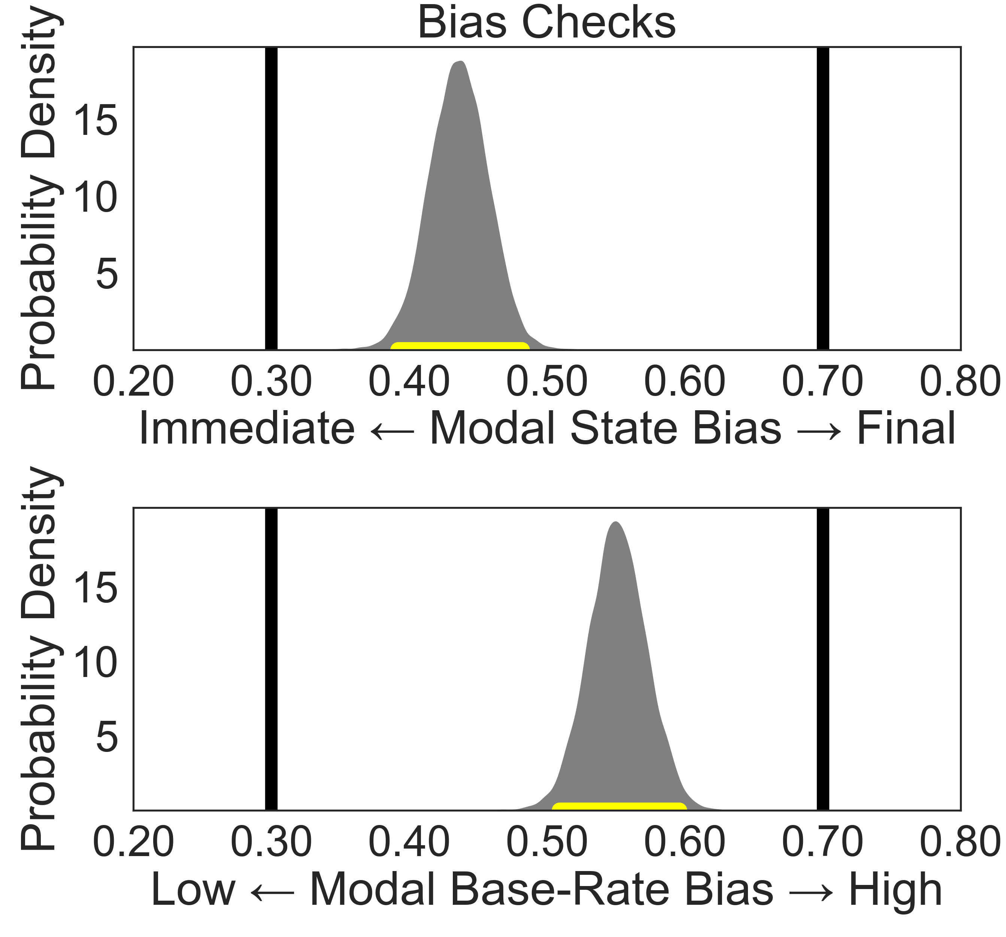
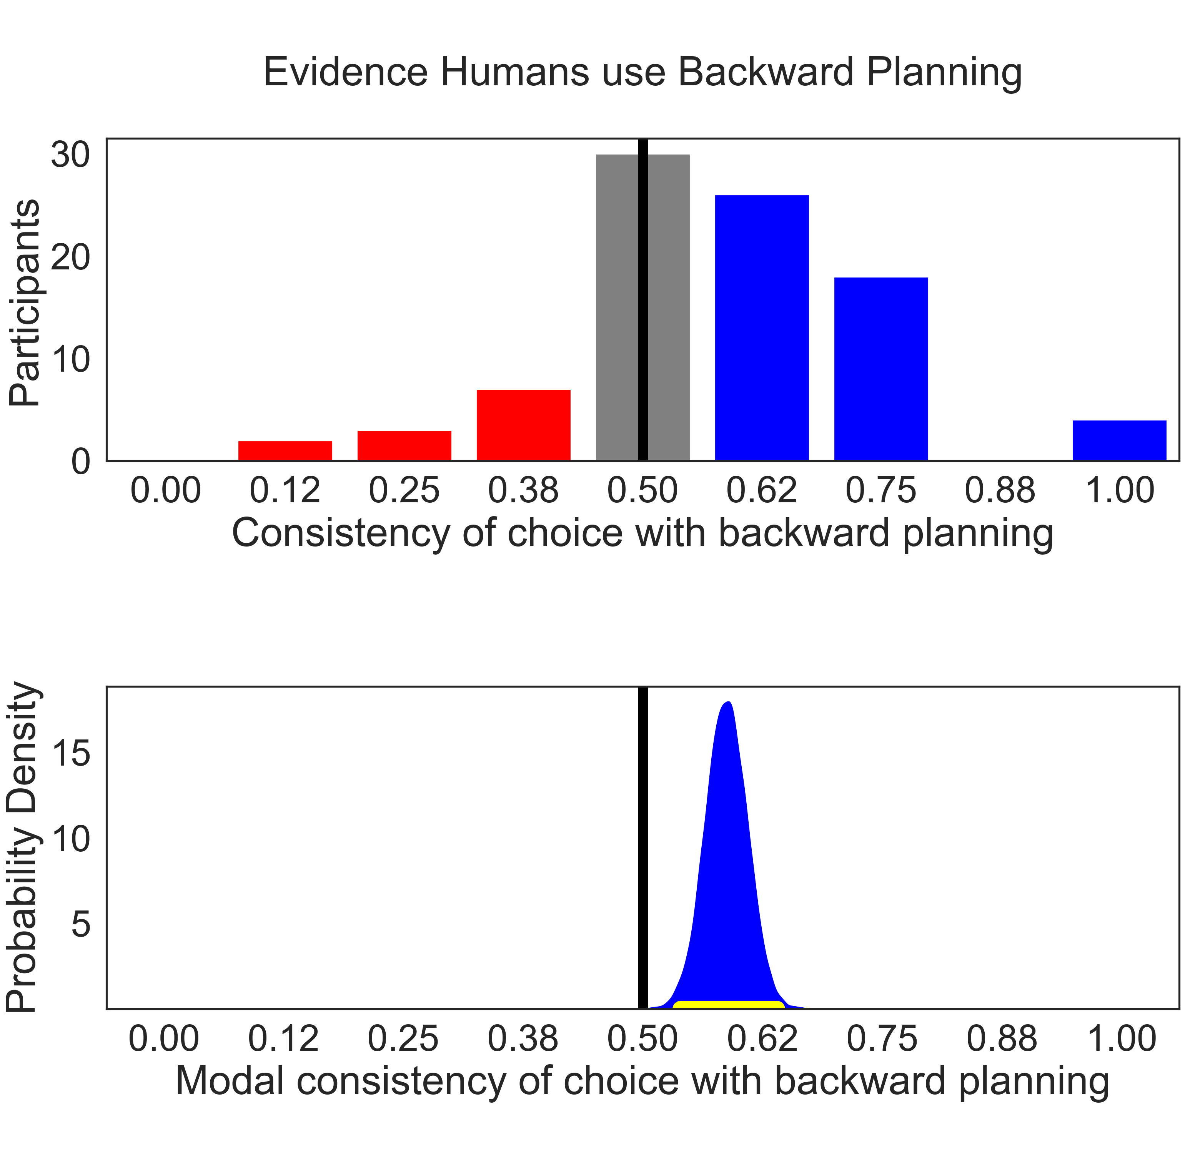
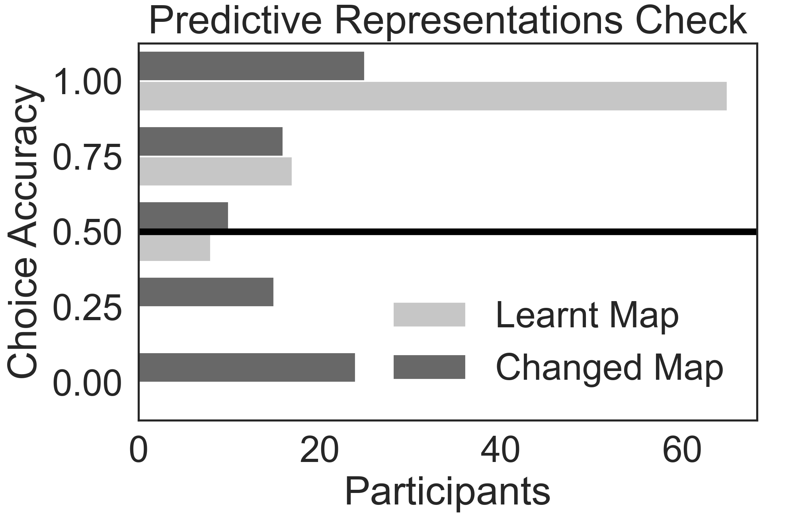

Slide 8




Forward Planning
State Space
Backward Planning
15
Base Rate
60
40
100
100
23
100
0
1
Fwd probability
0
state transition probability
1
0
1
Bwd probability
Notes:
if current_outcome>0:

Slide 9
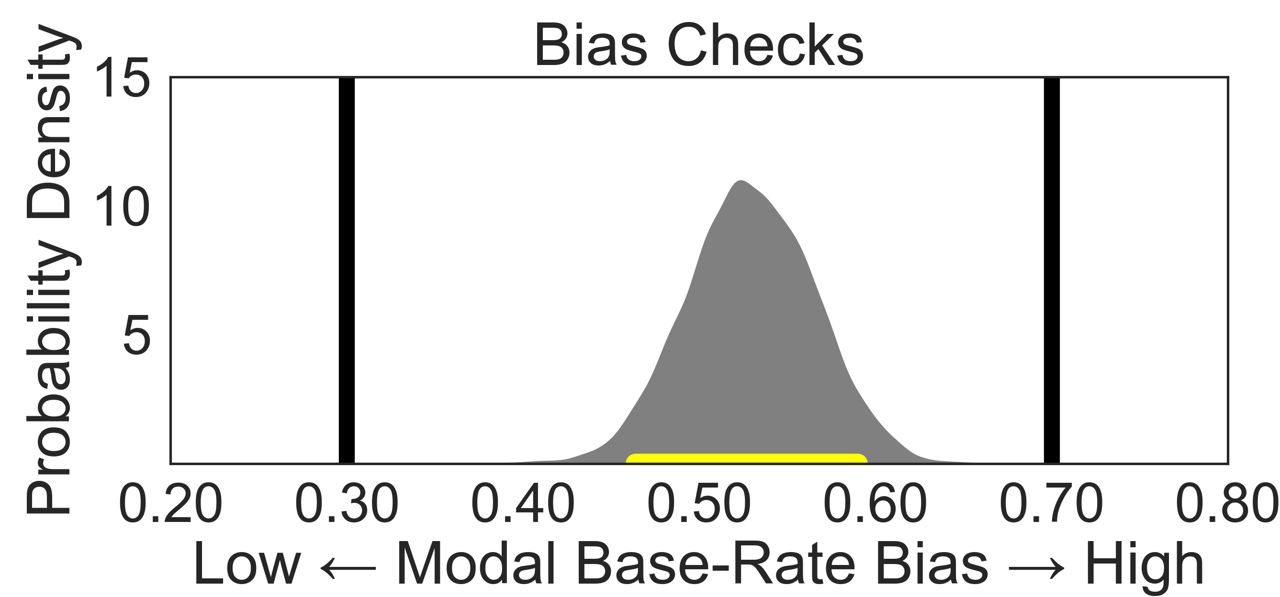
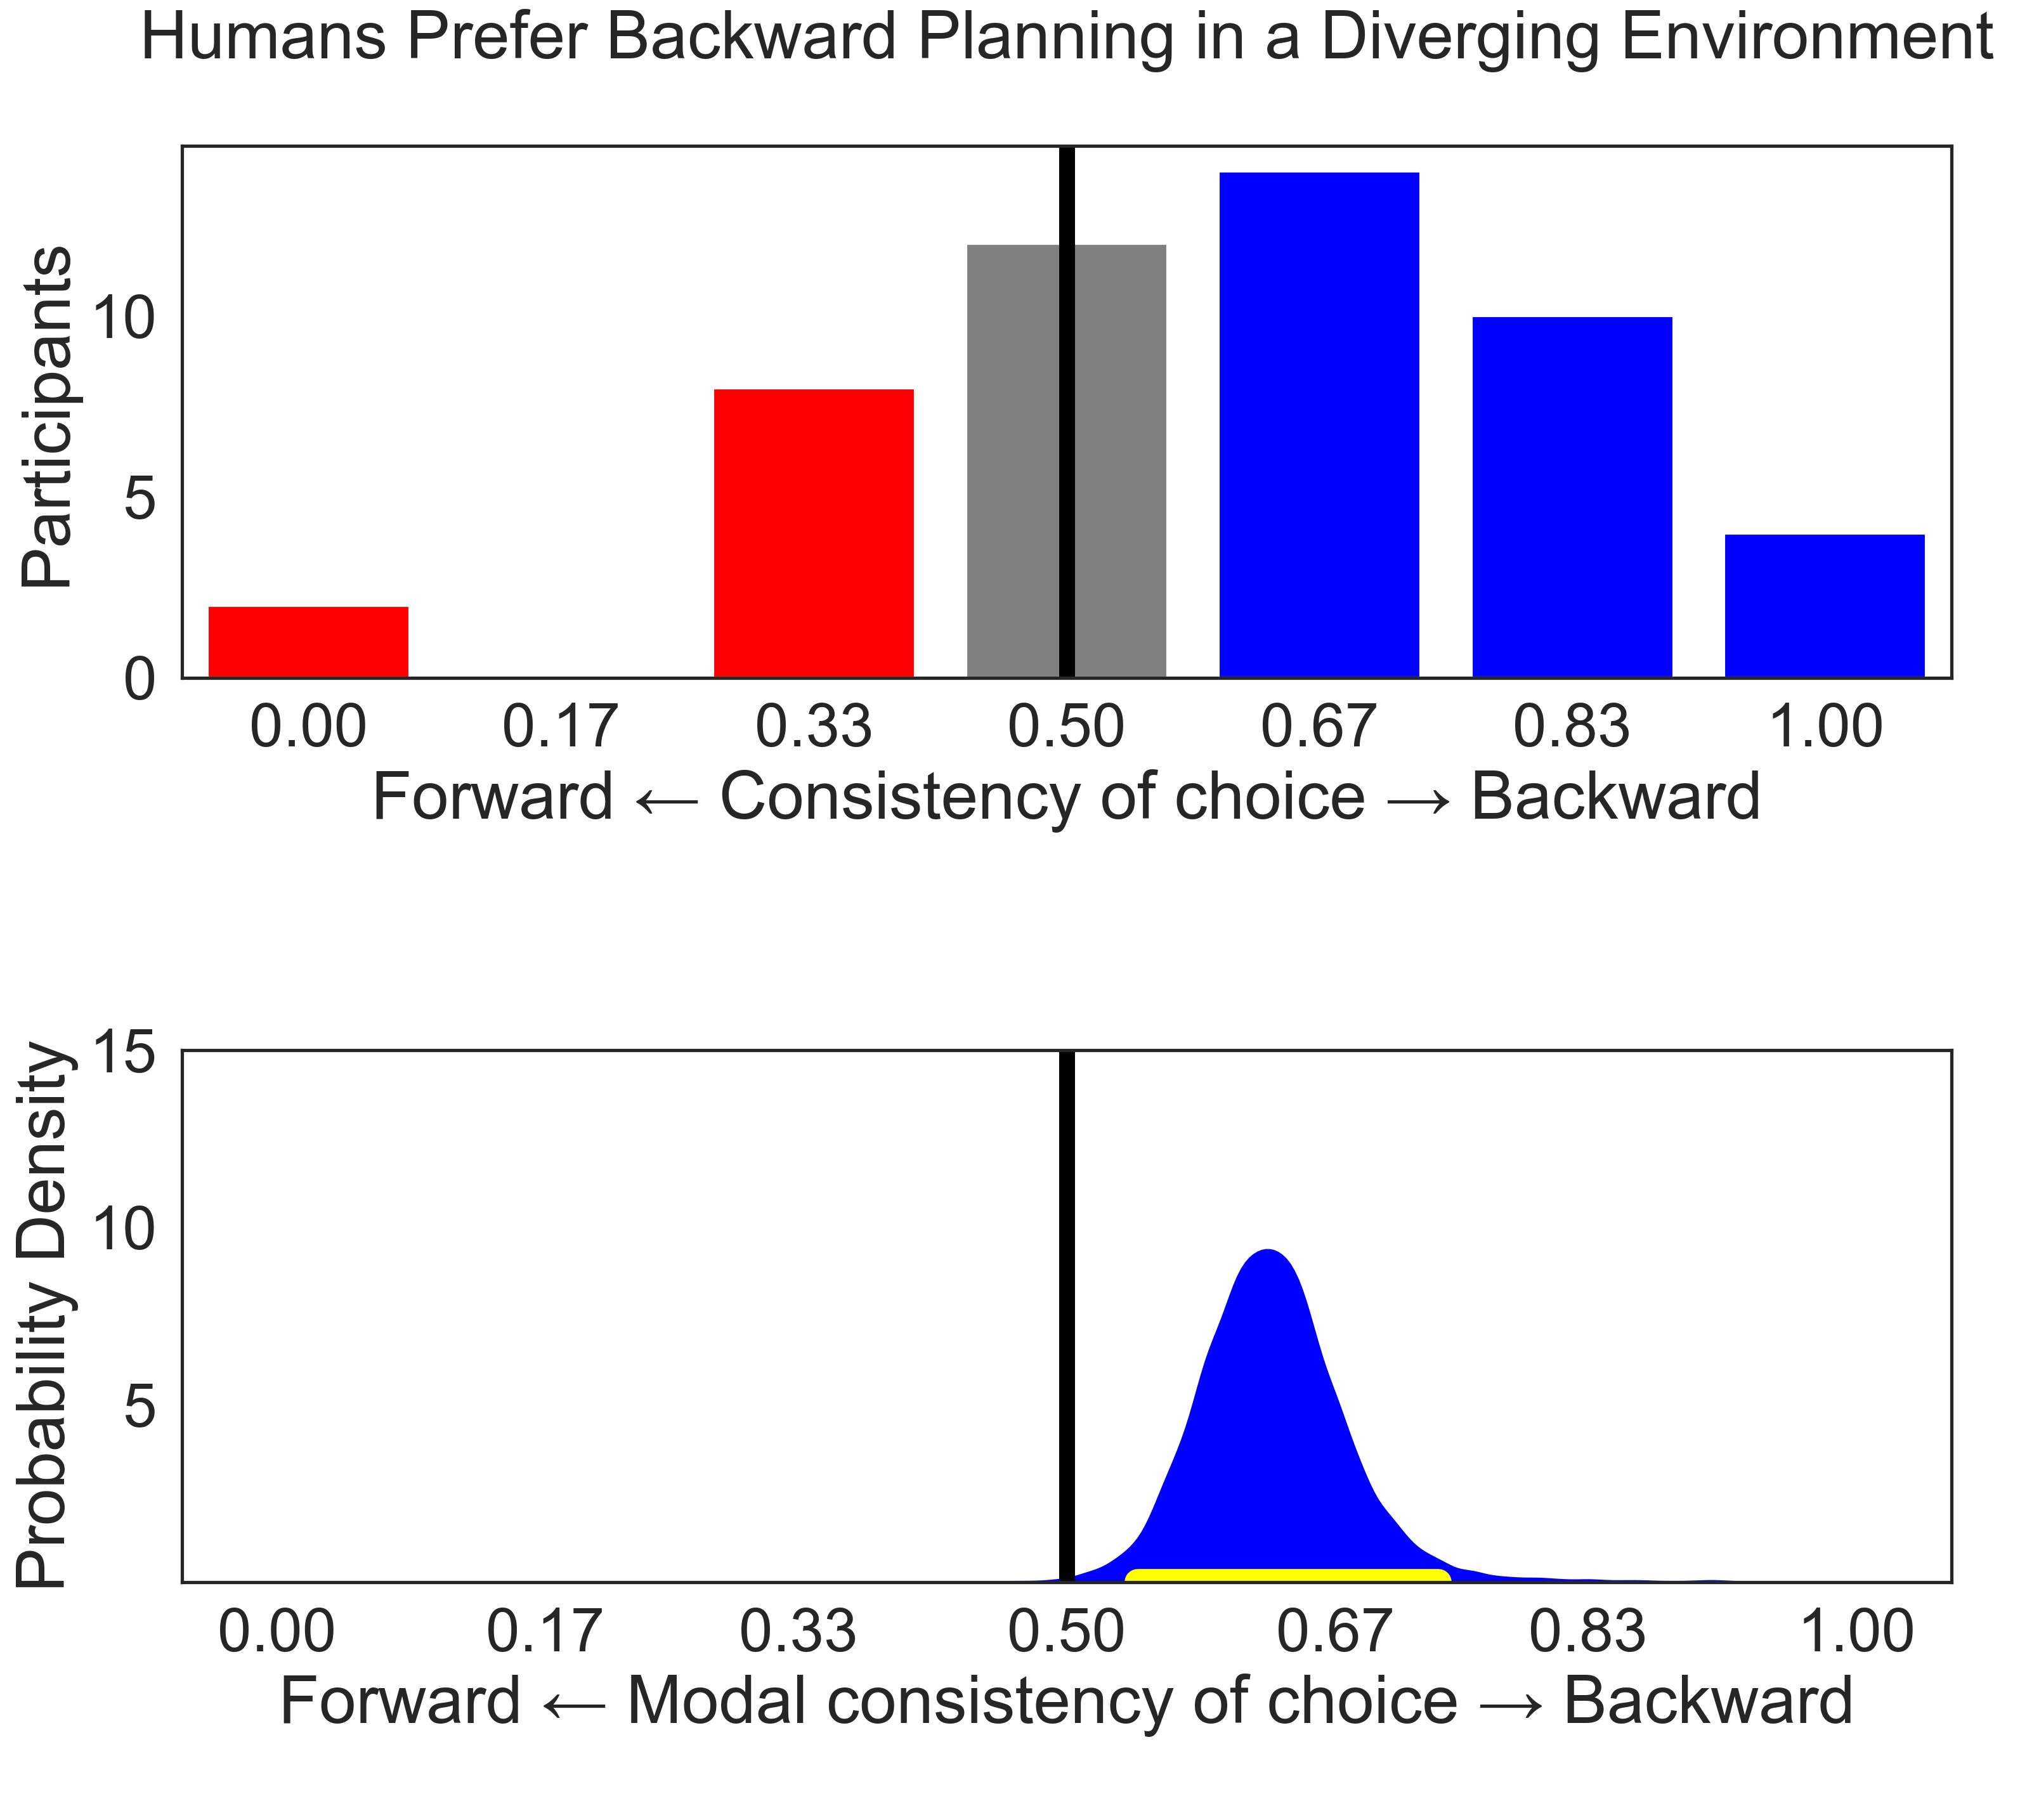
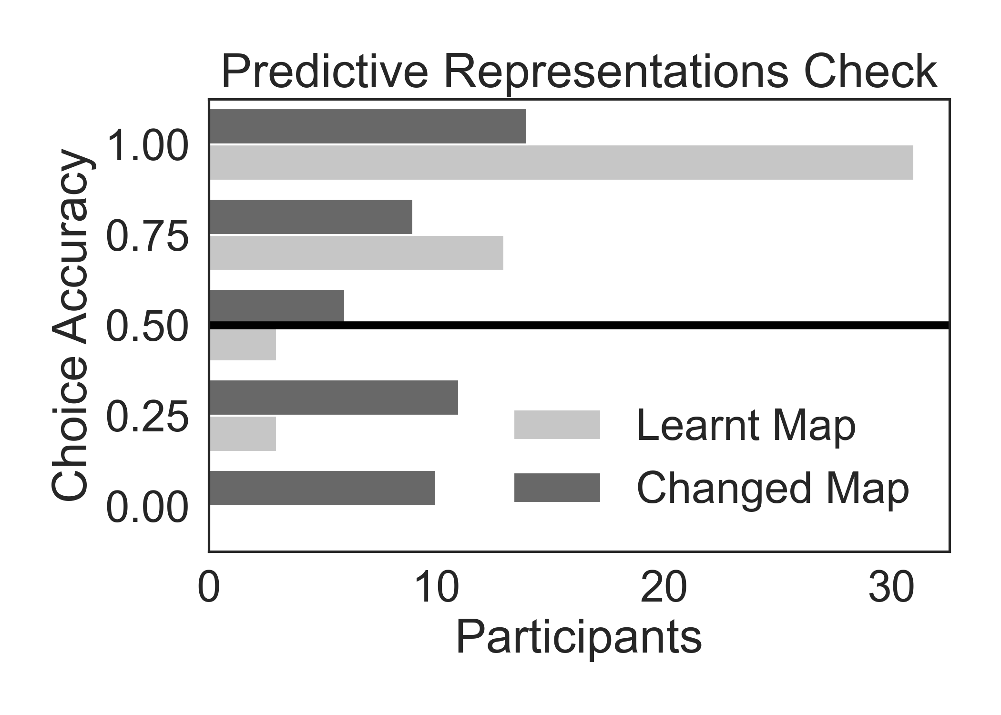

Slide 10
Forward Planning
State Space
Backward Planning
60
Base Rate
12
19
100
100
40
0
1
100
Fwd probability
0
1
0
1
state transition probability
Bwd probability

Slide 11
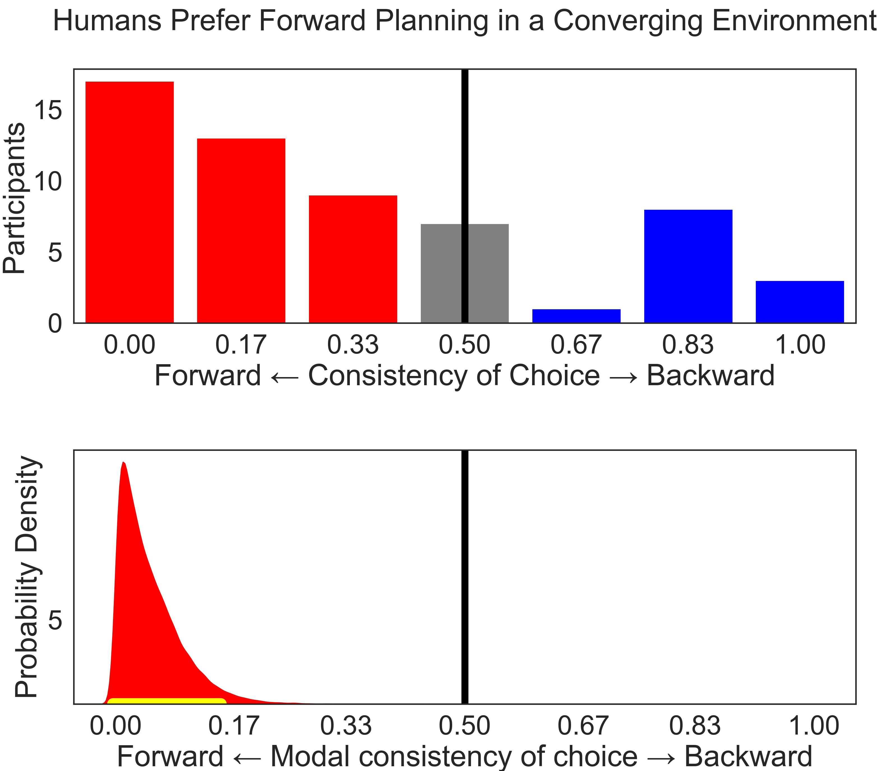

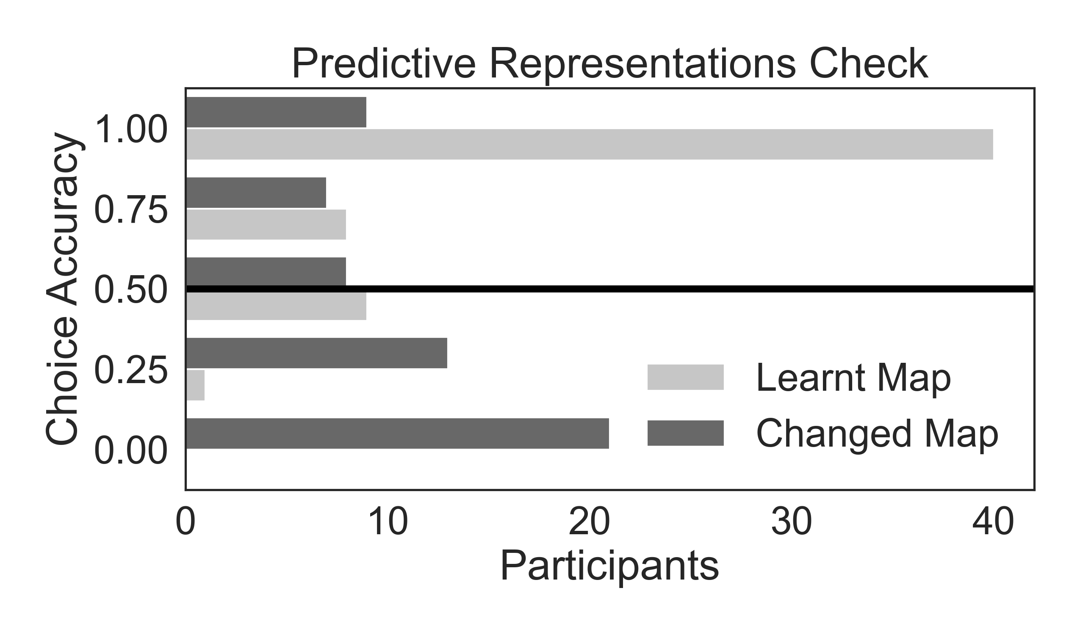

Slide 12
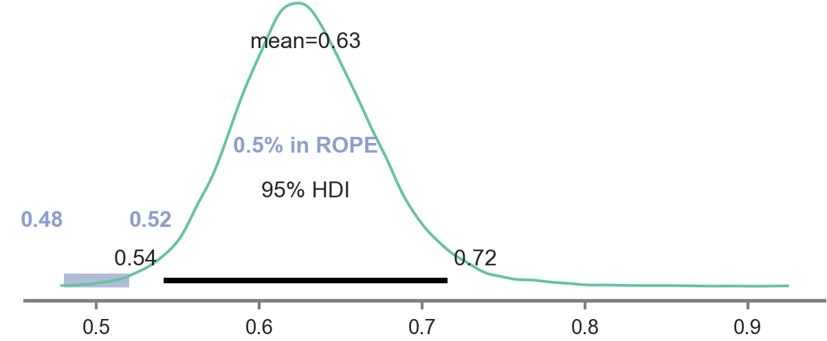
Base Rate
probability density
evidence of PR
0
1
state transition probability
60
40
15
23
100
100
100
Notes:
if current_outcome>0:

Slide 13
Base Rate
137
0
state transition probability
1

Slide 14
84
53
137

Slide 15
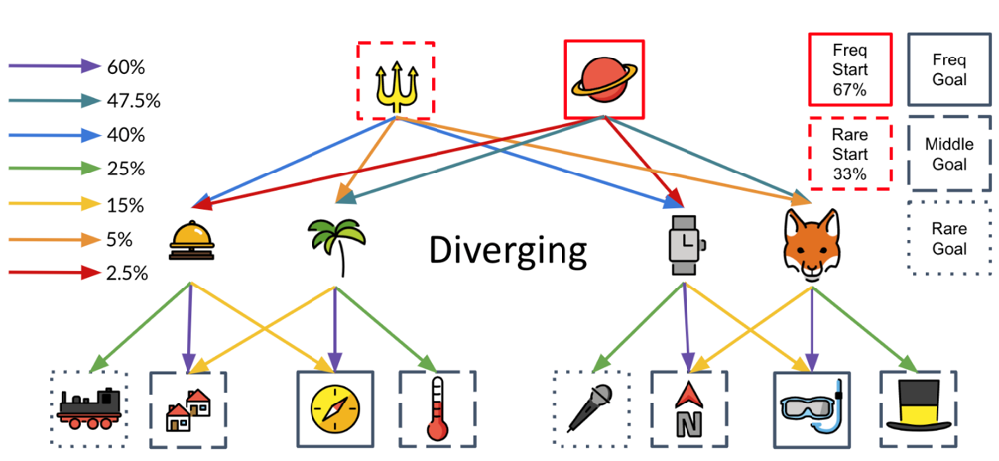
\\

Slide 16
Base Rate
0
2
cumulative forward probability
0
2
0
2
cumulative forward probability
cumulative backward probability

Slide 17
p( | )
p( | )
High
Base-Rate
Low
Base-Rate
High
Base-Rate
Low
Base-Rate
60%
40%
60%
40%
High
Base-Rate
Low
Base-Rate
23%
15%
fox | 156 | houses | 208 | north | 137

Slide 18
p( | )
p( | )
→
SR
23%
15%
←
PR
60%
40%

Slide 19
High Base Rate (112/520)
Low Base Rate (50/520)
Lowest Base Rate (32/520)
Probability Ratio: 6:4
100%
60%
40%

Slide 20
High Base Rate (112/520)
Low Base Rate (50/520)
Lowest Base Rate (32/520)
Probability Ratio: 6:4
100%
60%
40%

Slide 21
High Base Rate: 360 Total
Low Base Rate: 160 Total
45%
39%
30%
5%
1%
100%
50%

Slide 22
High Base Rate: 360 Total
Low Base Rate: 160 Total
Base Rate Ratio: 16:36
Probability Ratio: 6:4
1st to 2nd Transitions
100%
2nd to 3rd Transitions
50%

Slide 23
Single Goal Queries: Here, Snorkel
High Base Rate: 360 Total
Low Base Rate: 160 Total
1st-2nd Stage Transitions
30%
20%
PRG_Reward and SRG_reward diverge when the SNORKEL has the highest reward, because PR is sensitive to base rates.
These agents plan by determining the action that leads most often to the highest reward
SRG prefers TRIDENT (24%>16%) whereas PRG prefers (60%>40%).

Slide 24
3-goal query to determine PRG vs. PR
High Base Rate: 360 Total
Low Base Rate: 160 Total
1st-2nd Stage Transitions
60%
40%
Example Query:
Train=118
Compass=90
Houses=90
PR prefers PLANET because it is the highest reward: EV ratio = 64:36
PR_EVavg prefers TRIDENT because it averages over multiple rwds: EV ratio = 64:36

